Slide 1

The more you pro!!
An ArcGIS Pro intro
Tanya Owens, MS-GIST
May 2020

Slide 2
PRO Basics
Ribbon with Tabs
  Same as Word, Excel, Outlook, etc.
  ArcMap toolbar is now the Ribbon
Panes/Views
  Instead of dialog boxes like ArcMap
  Contents Pane is ArcMap Table of Contents with some added features
  Catalog View for Metadata
  https://pro.arcgis.com/en/pro-app/help/projects/the-project-pane.htm

Slide 3
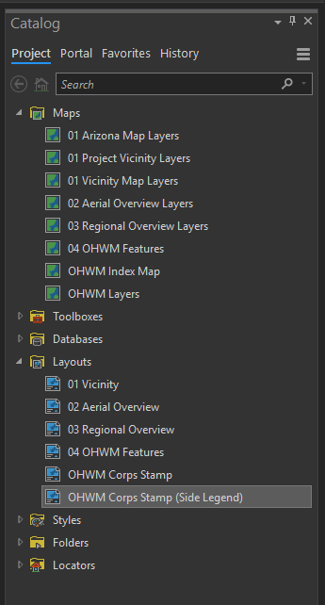
Multiple Maps, Layouts
Contextual
  Ribbon tools work only on what layer/feature is selected in the Content Pane or Layout Item
Layout (pagx) vs. Project (aptx) template files
  Any data in a project template will be duplicated in the newly created project

Slide 4
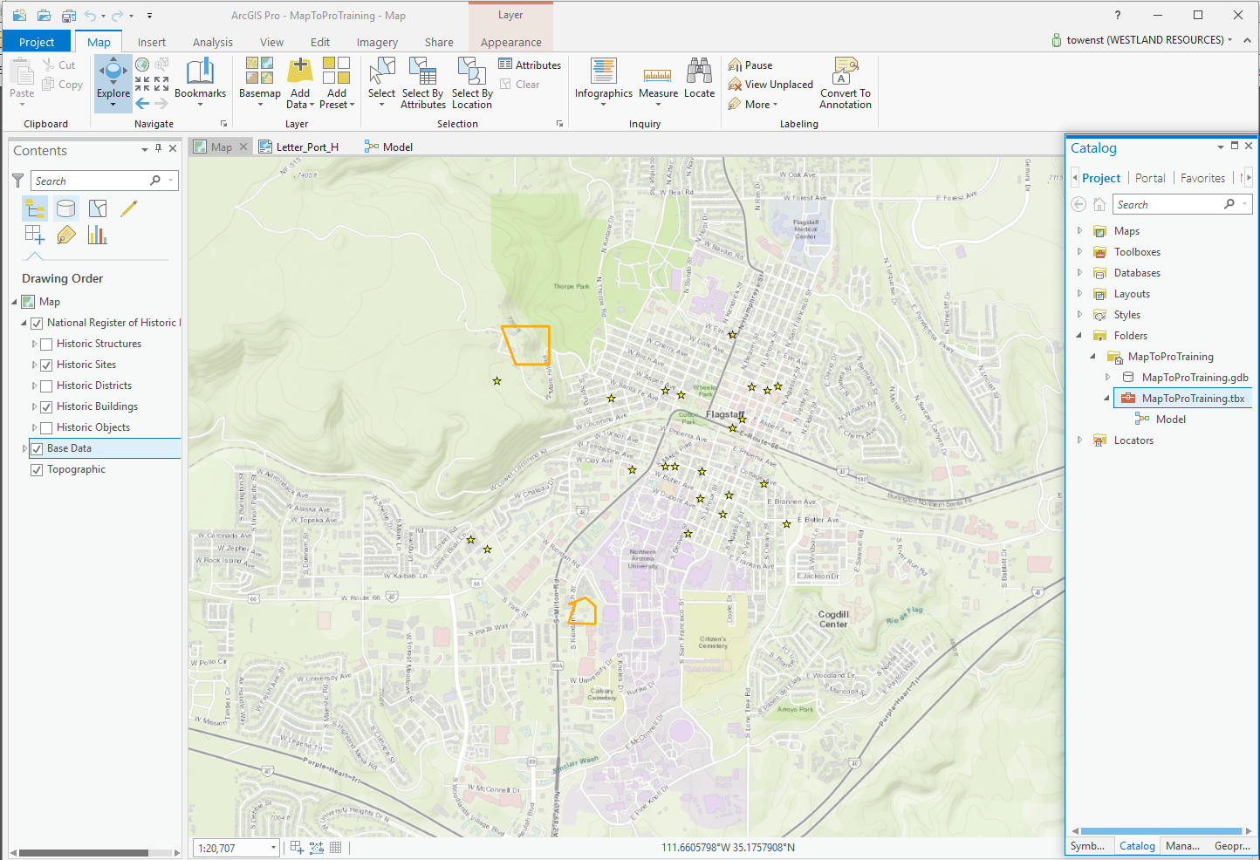
Notes:
Contextual data/Ribbon interface
ID Tool and Panning is like using ArcGIS Online
Content Pane
Editing options

Slide 5
Folder Connections
  Can be added via the Catalog Pane
  Can drag and drop from windows file explorer
Right Click still works!!
  It has mostly the same selections available as ArcMap does
You can customize
  Create a custom tab in the Ribbon
  Favorites in the catalog can be created that will show up in all .aprx projects
  You can add items to the Quick Access Toolbar

Slide 6

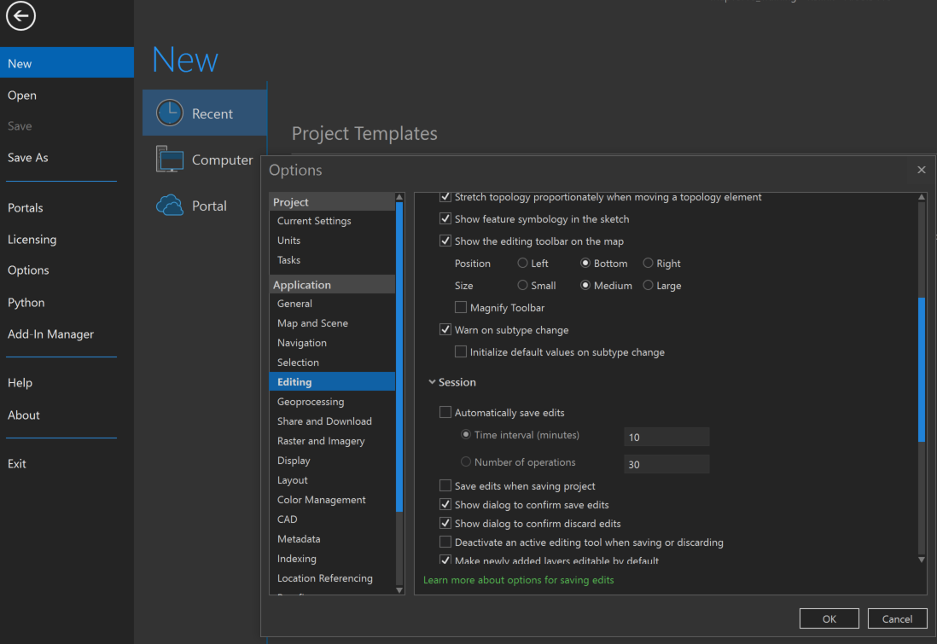

Pro Options

Slide 7
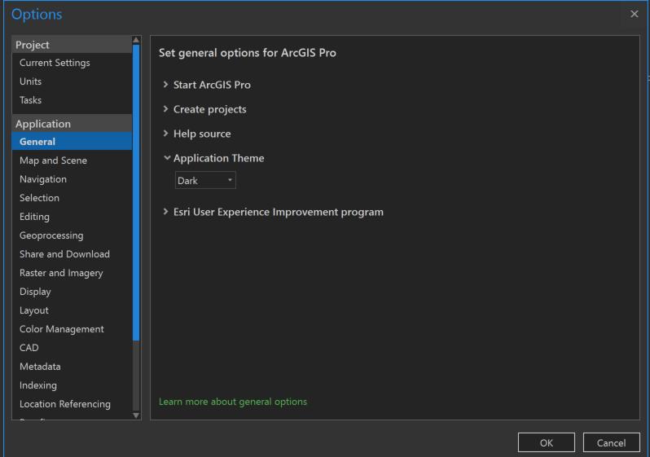

Slide 8
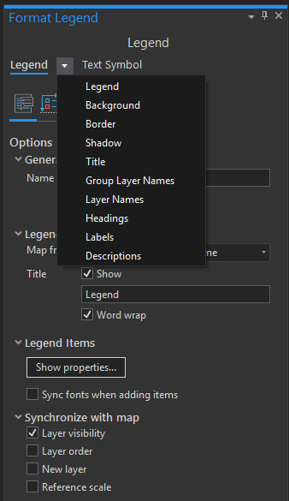
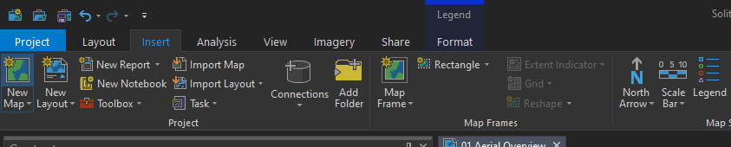
Legends
Legend Items
  Select legend Item to adjust that item only
  Think of it as contextual like the ribbon
  https://pro.arcgis.com/en/pro-app/help/layouts/work-with-legend-items.htm

Slide 9
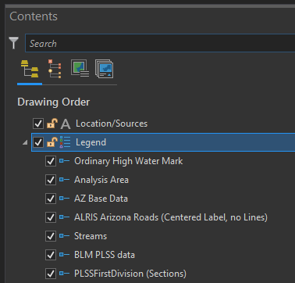
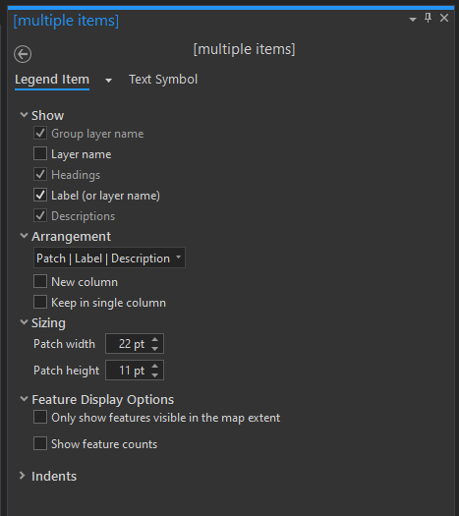
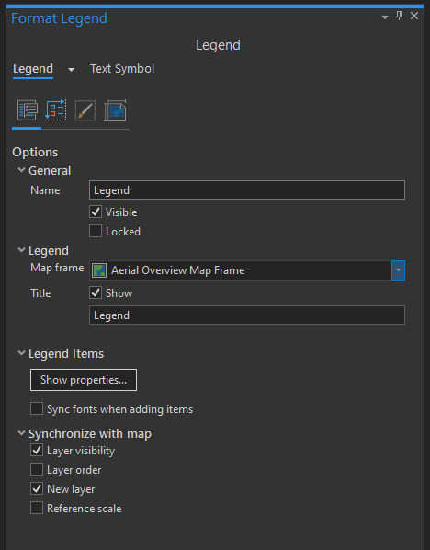

Slide 10
Styles – pro stylx
Import your styles from ArcMap into Pro
  In Catalog, right click on styles choose import and navigate to your ArcMap Style in a saved folder
To add these styles to favorites
  Right click on the style in catalog and choose manage, it will open a new catalog window that will allow you to right click on any item and add to favorites
  Stylx favorites are an individual Pro setting (not part of templates or company styles)

Slide 11
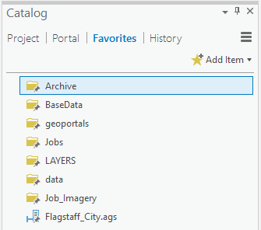
Services and folder favorites
In Catalog Pane, add all folders and GIS services to the favorites tab
Right click on added item and set it to “Add to New Projects” to add that favorite to all future projects

Slide 12
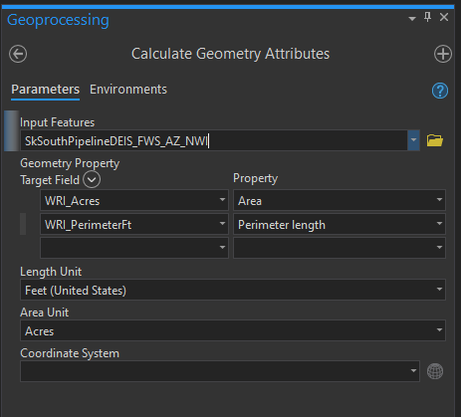
ArcGIS Pro is adding new features every day and even improved features
You can now Calculate Geometry on multiple fields

Slide 13
websites
Getting started with pro – tips and shortcuts, help
  http://pro.arcgis.com/en/pro-app/get-started/shortcuts-in-arcgis-pro.htm
  https://pro.arcgis.com/en/pro-app/help/main/welcome-to-the-arcgis-pro-app-help.htm
Pro Terminology Guide
  http://www.esri.com/library/brochures/pdfs/arcgis-pro-terminology-guide.pdf
Customization
  http://pro.arcgis.com/en/pro-app/get-started/customize-the-ribbon.htm
  https://blogs.esri.com/esri/arcgis/2017/12/04/arcgis-pro-customization-an-arcmap-style-toolbar-for-arcgis-pro/
Roadmap for ArcGIS Pro
  https://community.esri.com/docs/DOC-14549-arcgis-pro-roadmap-february-2020
Notes:
They are adding new content with every update
Google – your new best friend for Pro issues – Type ArcGIS Pro then your problem

Slide 14

Tanya owens towens@westlandresources.com
928-225-2218

